Slide 1


Group number 7 AirLine management System
Web Technologies
1- Muhammad Talha Sharif( FA19-BCS-064).
2- Saad Ali (FA19-BCS-079).
3- Farhan Tariq (FA19-BCS-070).
Work and you’ll get what you need; work harder and you’ll get what you want.

Slide 2

Introduction
The first and for most aim of airline management system is to make sure the proper and smooth working of any airline compney. System should be robust enough that it can function continuously without any hikups and demanding near to zero maintainense

Slide 3

Meet Air Echo gREAT wINDS TO FLY WITH
Here at air echo we have designed the whole management system in such a way that works efficiently and at the same time being user friendly and intractive too. The system is so straight forward that company’s new employees can get used to in just few hours of intraction.

Slide 4
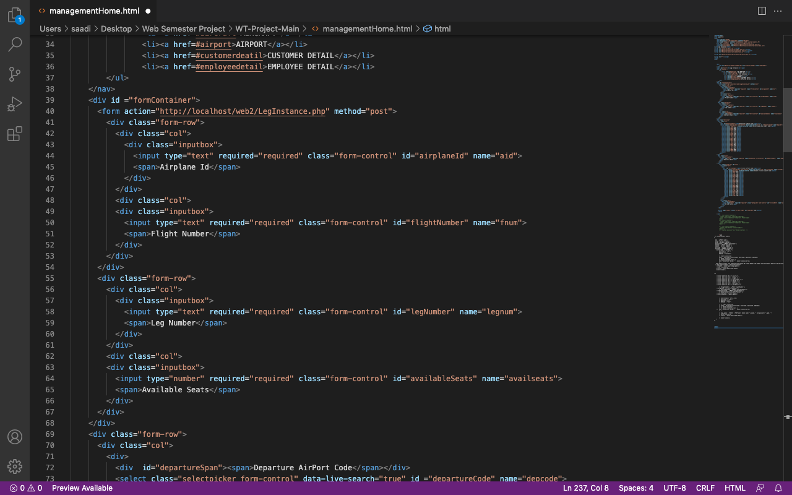
Deep dive into the system
Lets have deeper dive into the system.
This system by nature is web based. We collect then we manage then sort then refine then we do mix and match then process and then finally store the data on our base. Whole system is based on following scripting languages
1- Java script 73.6%.
2- CSS 10.6%.
3- PHP 8.6%.
4- HTML 7.2%.
Tools that we used to develop and integrate the whole system
1- Visual Studio code.
2- XAAMP.
3- PHP MY,ADMIN

Slide 5
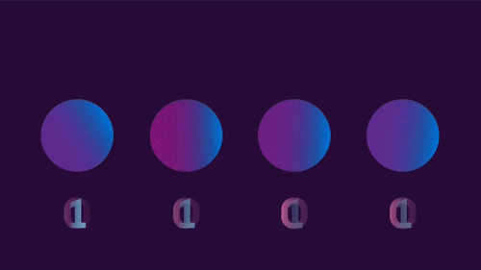
System Modules
This System has in total 11 modules each module having its own javascript and css sheet. All the modules are working as they are supposed to. Every single module have its own defined data type for storing and sorting data. Not only that each of them have their own UI and are integrated so well that there is minor chance of glitch. All of them have been listed down below.
1- Add Flight.
2- Flight leg.
3- Air Craft.
4- Employee Detail.
5- Add Employee.
6- Leg Instance.
7- Airport.
8- Home.
9- Employee Login.
10- Admin Login.
11- Customer Login.

Slide 6
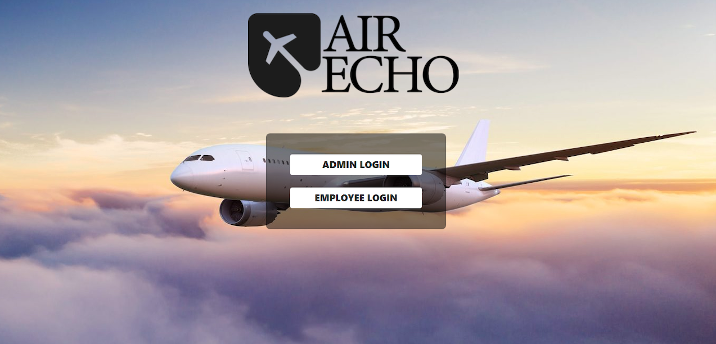
Greet UI simple YET Attractive
What we believe is that if the Ui is simple easy to understand but at the same time is attractive then it does increase the productivity that’s why we made the mix and match of flat,colory and animated ui’s and inherited it into our system UI. You will see the glimps of it in next few slides

Slide 7
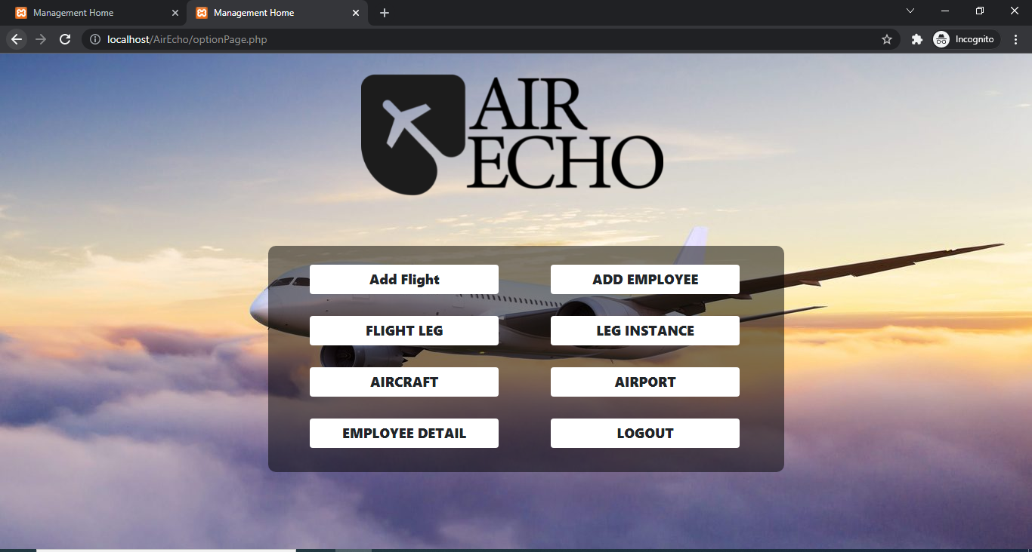
Management home module

Slide 8
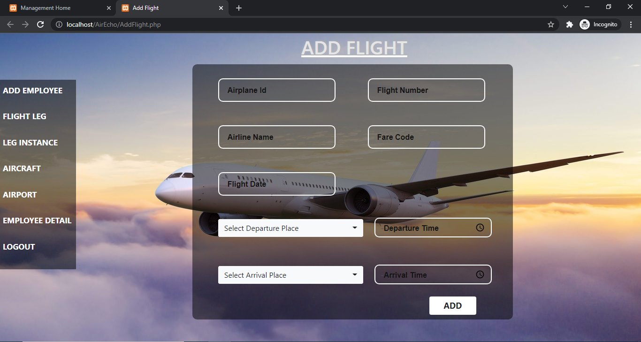
Add Flight Module

Slide 9
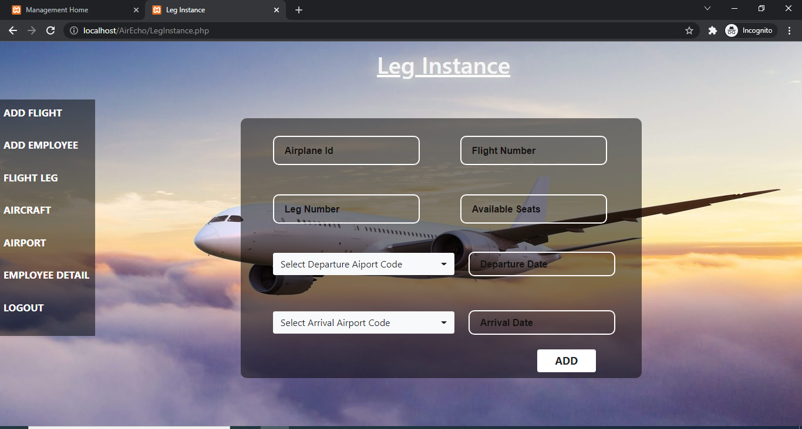
Leg instance module

Slide 10
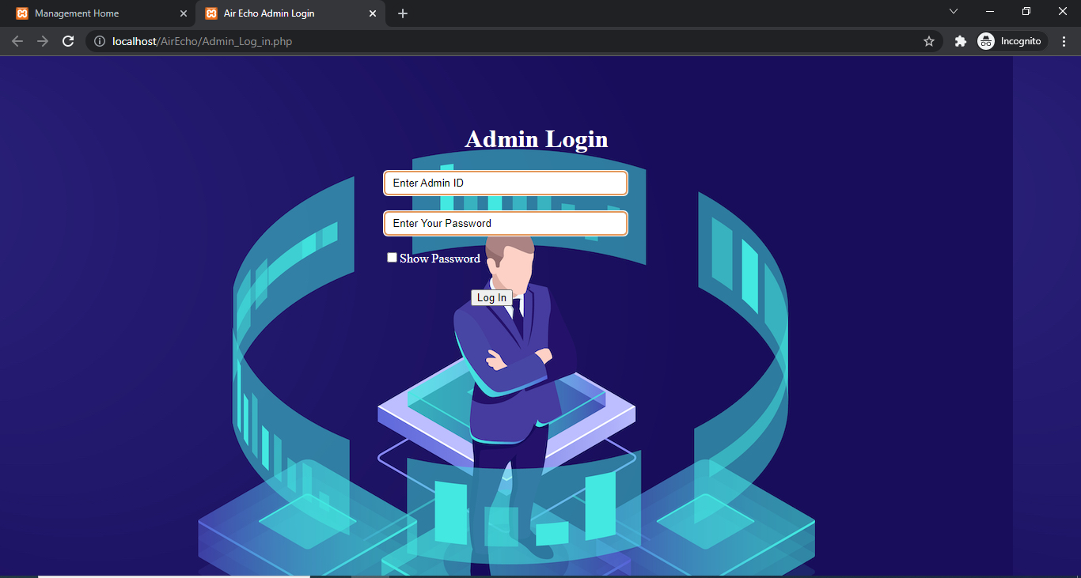
Admin LOGIN

Slide 11
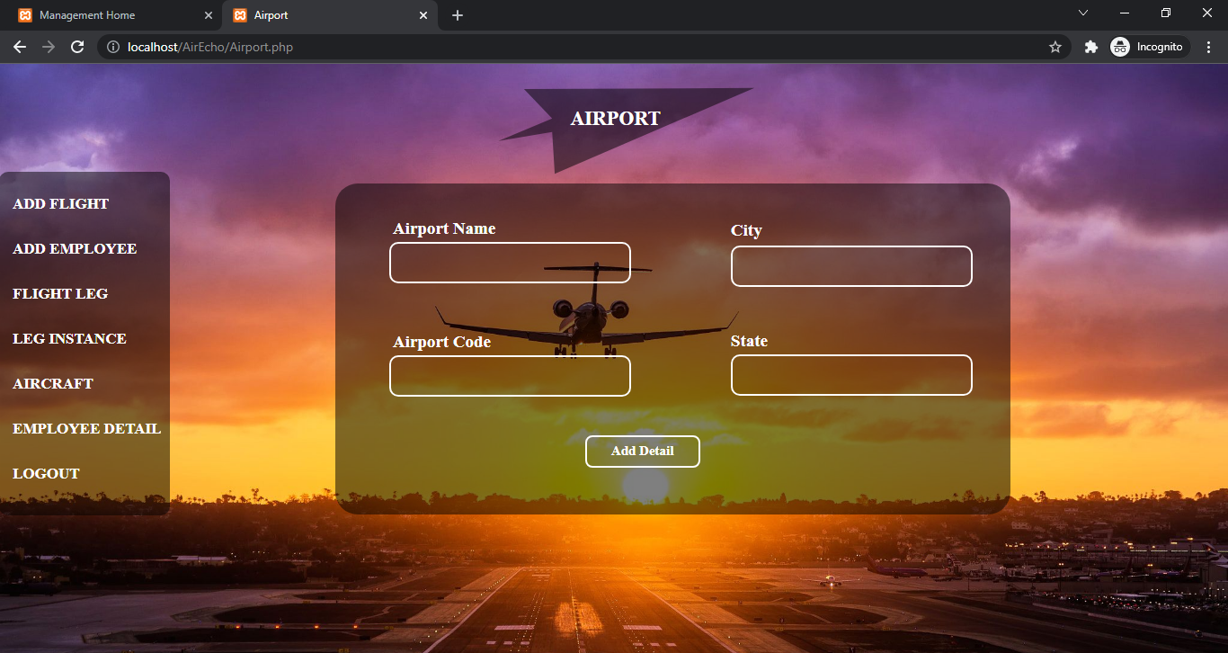
Airport module

Slide 12
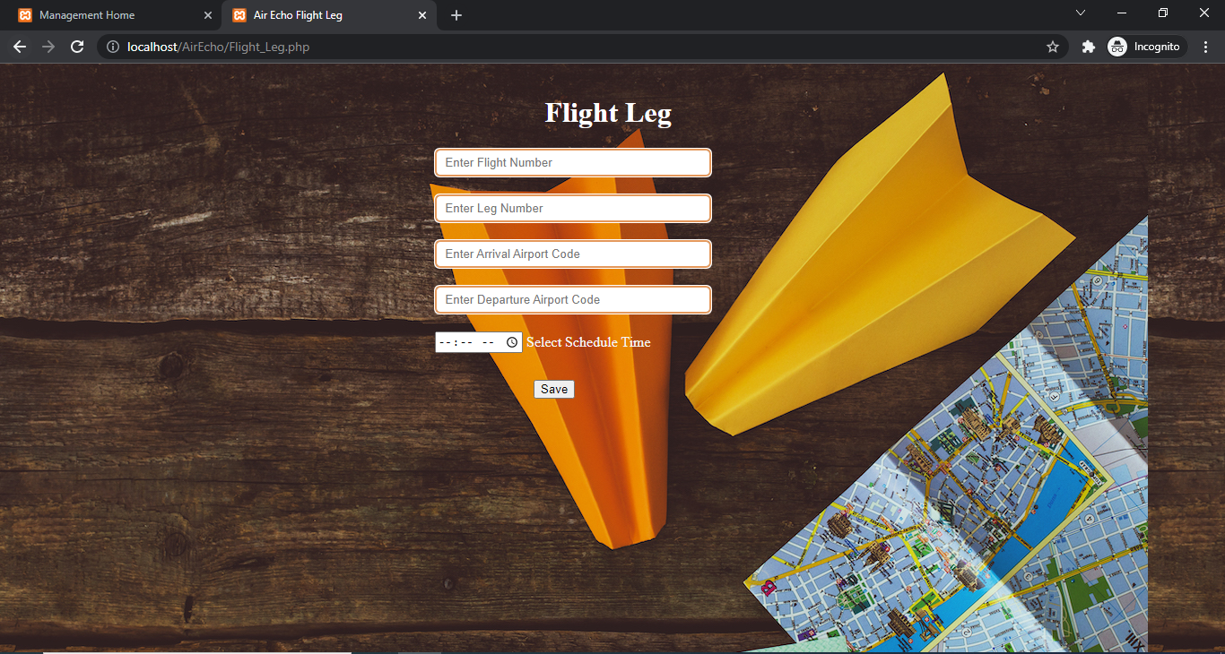
Flight Leg module

Slide 13
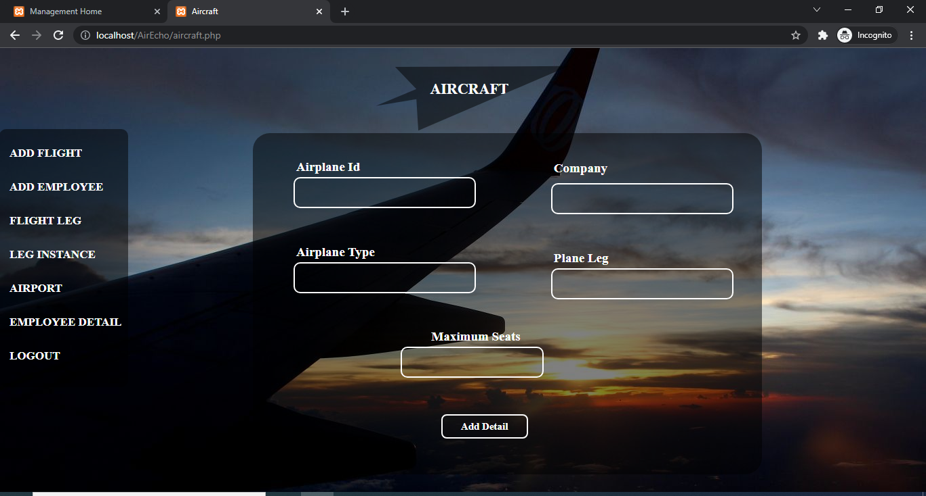
Air craft module

Slide 14
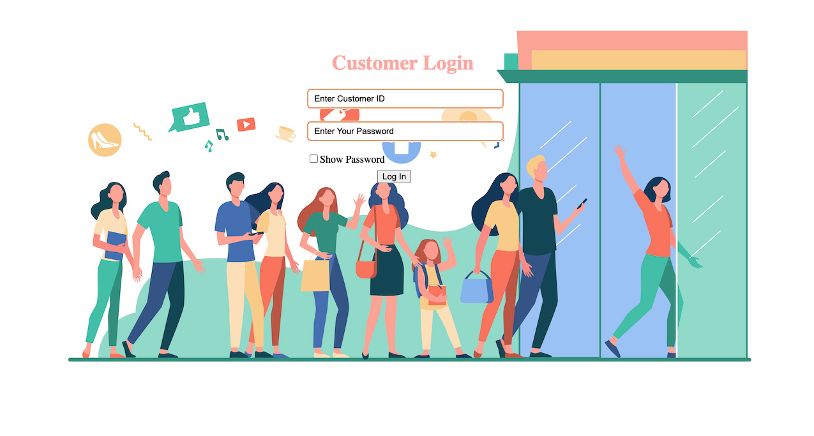
Customer login

Slide 15

Thank You

